Slide 1
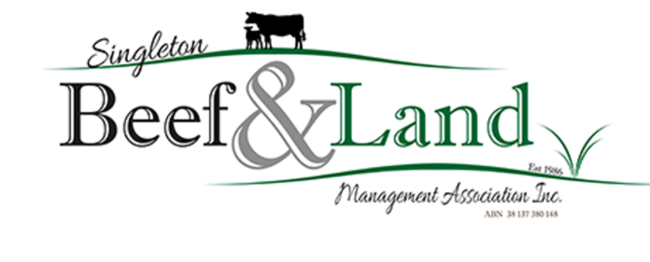

Pastures ‘Not just grass’
Prepared by Neil Nelson, Agronomist, Neil Nelson Agvice PTY LTD, for Singleton Beef & Land Management Association.
Proudly supported by

Slide 2
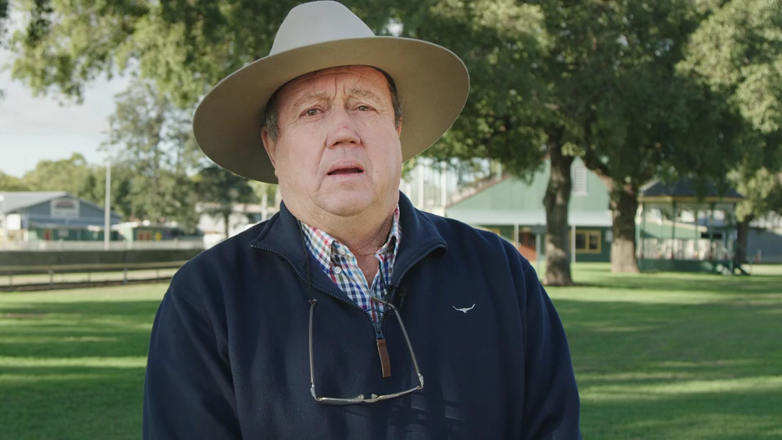
Watch: Welcome & enjoy!

Slide 3
Livestock rely on pastures
Did you know?
Most Australian cattle are raised on pastures, including Australia’s breeding herd.
Feedlots are used to finish and fatten cattle for specific markets (e.g. export, domestic trade).
Supplementary feeding is used during droughts, poor seasonal conditions and when pasture alone is not able to support grazing livestock.
Pastures Types
Forage Crops are generally re-sown each season for high production, high quality feed or hay/silage production.
Pastures are usually grown for long term production.
Forage Crops | Pastures (Annual) | Pastures (Perennial)
Grazing Oats | Ryegrass | Most Native grasses
Forage Brassica | Sub-clover | Lucerne
Persian Clover | Medic | Phalaris, Cocksfoot
Italian Ryegrass | Arrowleaf Clover | Kikuyu
Forage Sorghum | Serradella | Rhodes grass

Slide 4
Life cycle of common pastures
Annual | Biennial | Perennial
Grows one season only | May survive over several seasons | Long Lived species Survives several years
Oats Subclover | Forage Ryegrasses Some Brassicas | Native grasses Kikuyu Lucerne
Forages need to be re-sown. Pasture seeds for regeneration in following years. Usually have vigorous seedlings. Often have shallow fibrous root systems (e.g. ryegrass). | Produce forage for two seasons. Usually high quality, production feed. | Expected to survive as the same plant for years, seeding at least once a year. Slow to re-generate from seed. Have strong root systems (e.g. Lucerne tap root).

Slide 5
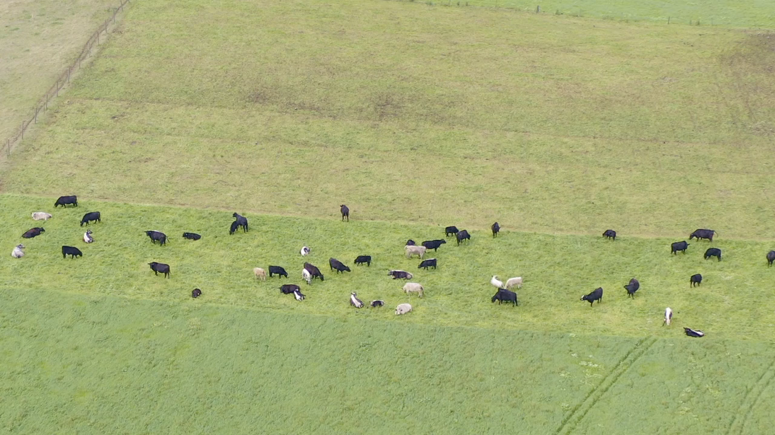
Watch: Annual vs Perennial

Slide 6
Types of pastures
Pasture | Example | Advantage | Disadvantage | Uses
Legumes | Lucerne | Nitrogen fixation (adds nitrogen to soil) | Bloat risk | High quality feed/hay
 | Clovers | High protein content | Bloat risk | Increases feed quality in pasture mixes
Temperate Grasses | Ryegrass | High quality feed | Weedy nature in cropping areas | Winter/spring feed
 | Phalaris | Persistent perennial | Slow establishment | Permanent pastures
Tropical Grasses | Kikuyu | Persistent and easy to manage | Summer growth only | Coastal pasture/silage
 | Rhodes Grass | Hardy, persistent | Low quality if rank | Competitive with summer weeds
Native Grasses | Weeping grass | High quality | Costly to establish | Good native pasture species
 | Wiregrass | Low quality | Low productivity, grass seed problems | Extensive grazing

Slide 7
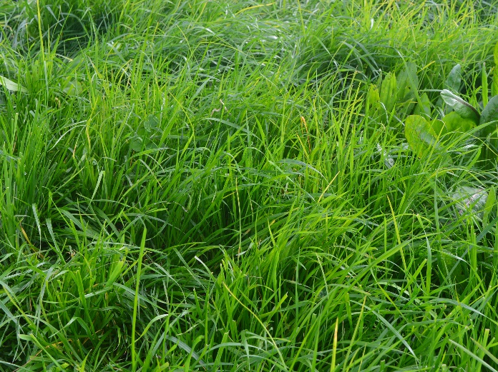
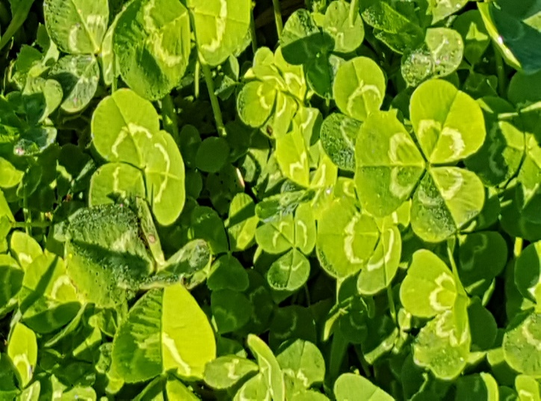
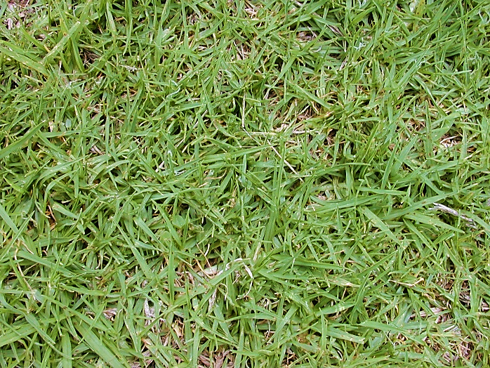
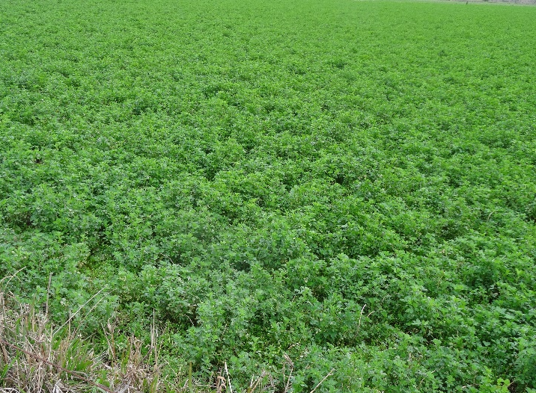
Examples of pastures
Ryegrass
Clovers
Kikuyu grass
Lucerne

Slide 8
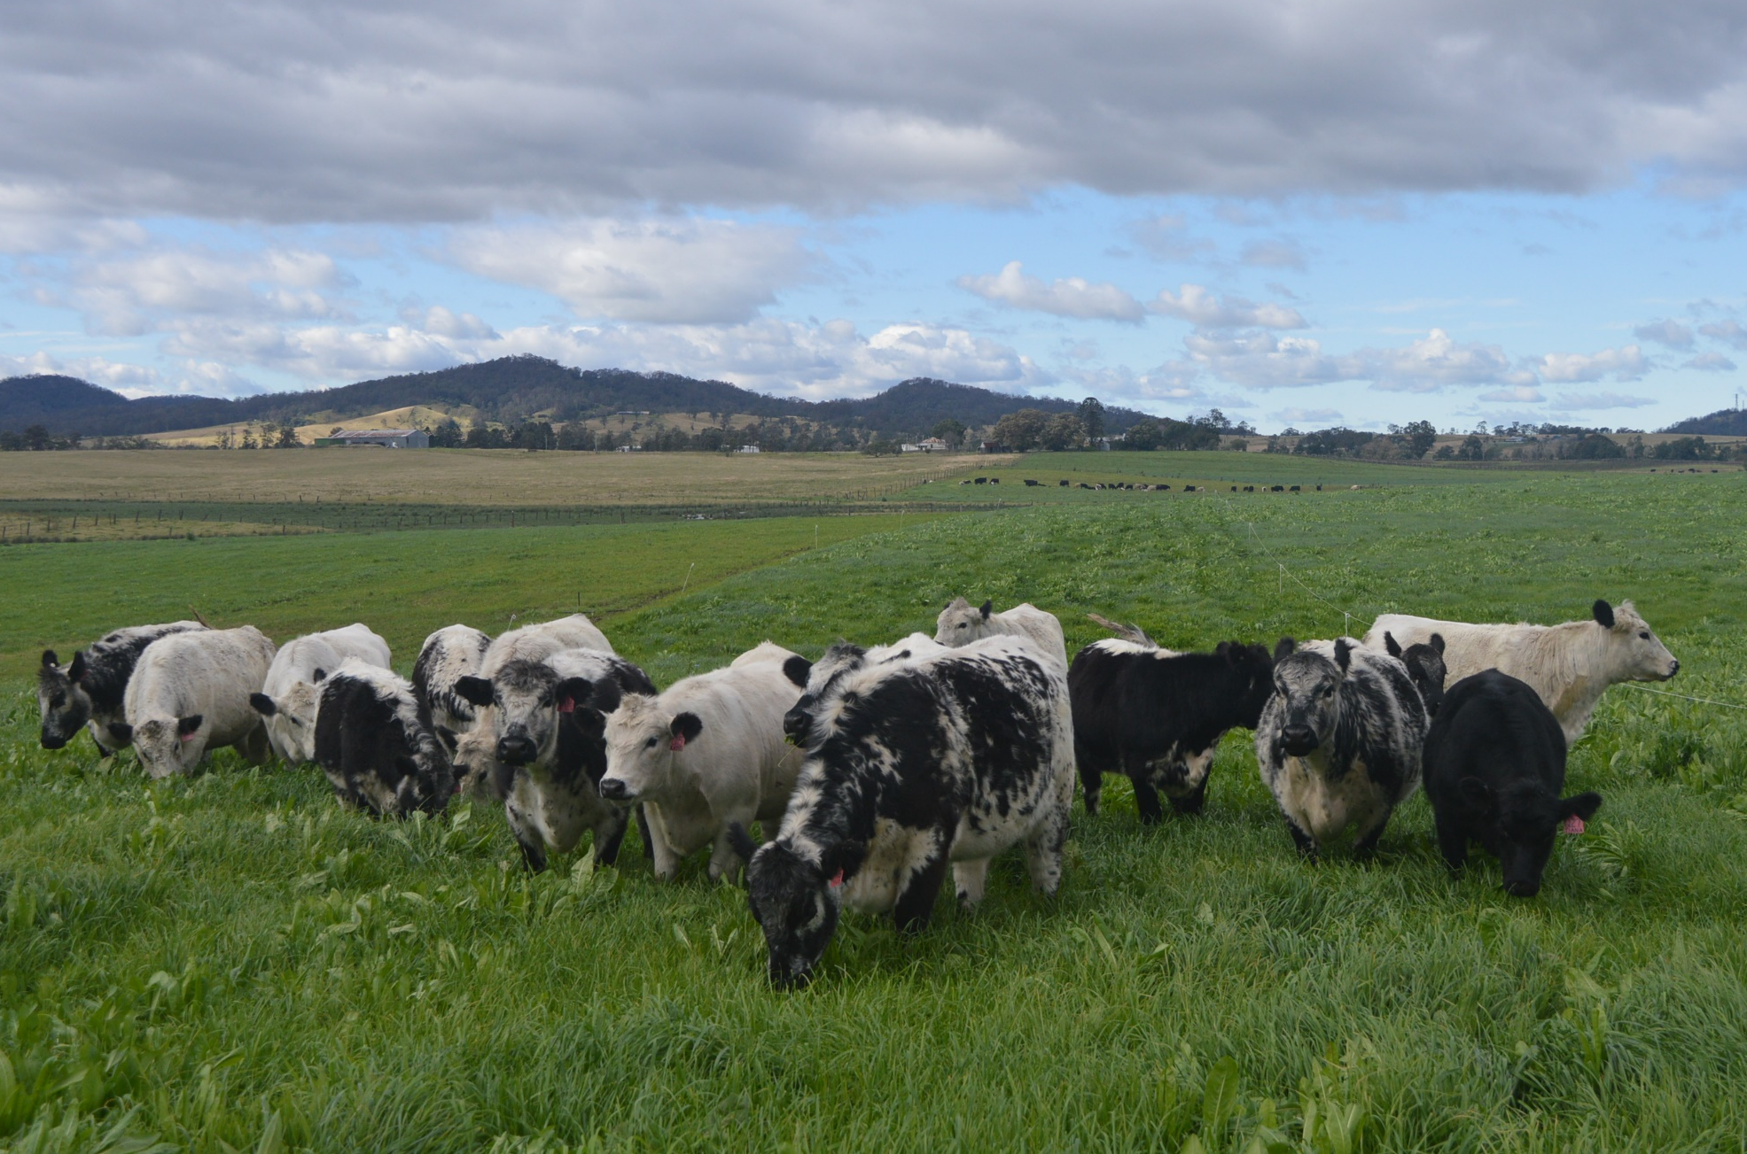
Can you guess the pasture type?
Ryegrass & chicory

Slide 9
Factors affecting livestock performance on pastures
Pasture Quantity
Pasture quantity includes how much, herbage mass and available feed.
Key points:
Measured as kilograms of Dry Matter per hectare.
Can only compare feeds on a ‘Dry Matter basis’.
Cattle usually eat a fairly predictable quantity of Dry Matter per day if feed is readily available.
Remember, the amount of pasture feed on offer to the animal has a major effect on how much it can eat.
Short , sparse growth may not allow the animal to eat enough to meet its daily requirements. As a result the growth rate will decline .
Pasture height and density are the two principle factors influencing how much pasture can be eaten in a day.

Slide 10

What’s Dry Matter ?
Most feeds contain water. However, this water content is ignored because it has no nutritional value.
Because of this, you can’t directly compare the weight of feeds with high moisture levels to weight of drier feeds.
Dry Matter percentage
This refers to everything in the feed sample other than water (including protein, fiber, minerals).
Dry Matter can be measured by drying and measuring the moisture lost.
Dry Matter % = 100 - Moisture content%

Slide 11
Dry Matter Content
Feed Type | Common Dry Matter Content (DM %) | Examples:
Young Leafy Pasture | 15 - 30% | Immature ryegrass, clovers
Mature grasses (flowering stage) | 40 - 50% | Once grasses mature they become stemmy as they flower
Dry Pasture in summer | 60 - 70% | Mature dry feed in summer
Hay | 80 - 85 % | Lucerne hay
Round Bale Silage | 35 - 40 % | Round bale ryegrass/clover
Cereal Grains | 90 % | Oats, barley, wheat
Straws | 90% | Wheaten, barley straw

Slide 12
How much pasture does a cow eat?
1 dry cow (450 kg) can eat 12kg DM/day
12 kg of DM can be equivalent to:
½ conventional bale of Lucerne hay
60 kg of Fresh leafy pasture
13 kg of grain
20 kg of old dry pasture or straw
Cows may graze for 5-6 hours in a day.
Pasture is rarely uniform. Cattle will select leaf before stem.
As pasture grows taller and older, feed intake will decline.

Slide 13
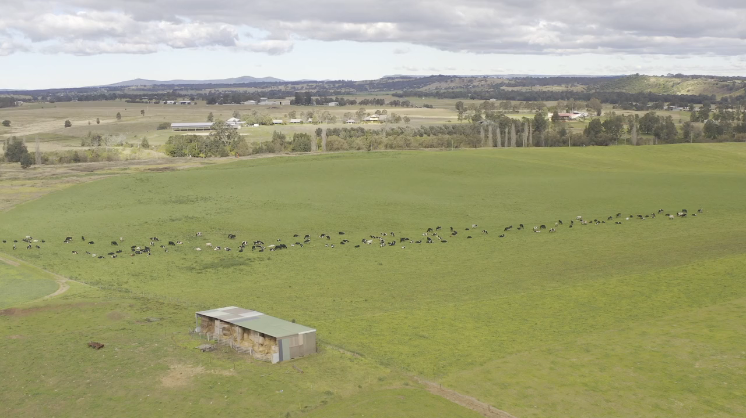
Watch: Importance of Dry Matter

Slide 14
Forage demand of different animals
Animal | Adult Equivalent | Liveweight (kg)
Weaners | 0.6 | 235
Heifers (1.5 -2.5 yrs) | 0.9 | 375
Steers (1.5 – 2.5 yrs) | 0.9 | 430
ADULT EQUIVALENT (Dry Cow) | 1.00 | 450
Cow and Calf <6 mths | 1.4
Steers (2.5 – 3.5 yrs) | 1.2 | 550
Bulls | 1.5 | 750
Horses | 1.2
Kangaroo | 0.07

Slide 15
The key factor in pasture quality is digestibility. Digestibility is the proportion of dry matter actually digested and utilised by the animal, with the rest passing out as faeces.
Factors affecting livestock performance on pastures
2. Pasture Quality
Key points:
High levels of animal performance require high daily intake of digestible forage.
Digestibility is affected mainly by its stage of development. As plants age, increasing amounts of structural carbohydrates and cellulose are produced to supply rigidity and support to plant structure. Stiff, coarse stems are poorly digested.
Clovers are highly digestible because of they have a lot of leaf and few flowering stalks.
Native grasses may have periods of high digestibility, but usually only for short periods as they mature quickly.

Slide 16
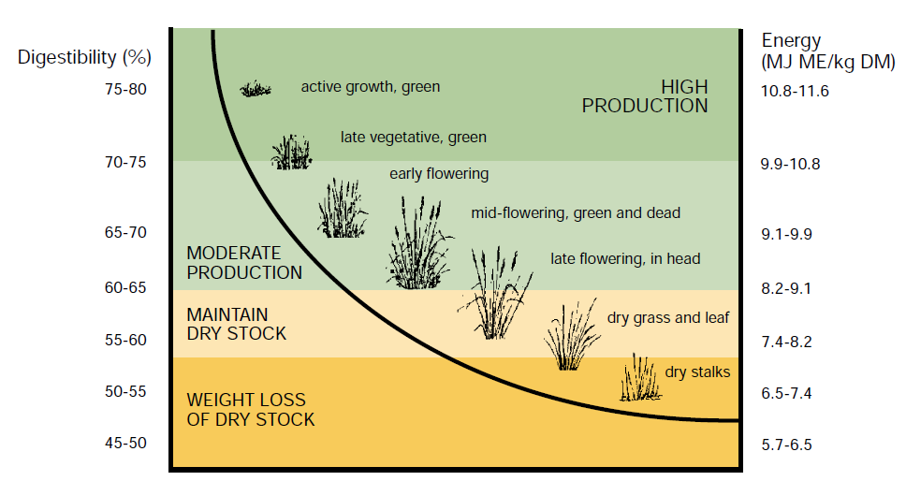
Digestibility Declines as
Pasture Matures
(Source: Prograze)

Slide 17
Other factors affecting voluntary feed intake:
Palatability
Poisonous factors
Mineral content of pasture
Environmental factors like heat stress
Nutritional requirement of the animal:
steers growing at 1kg per day
Dry cows
Cows raising a calf, lactating etc.

Slide 18
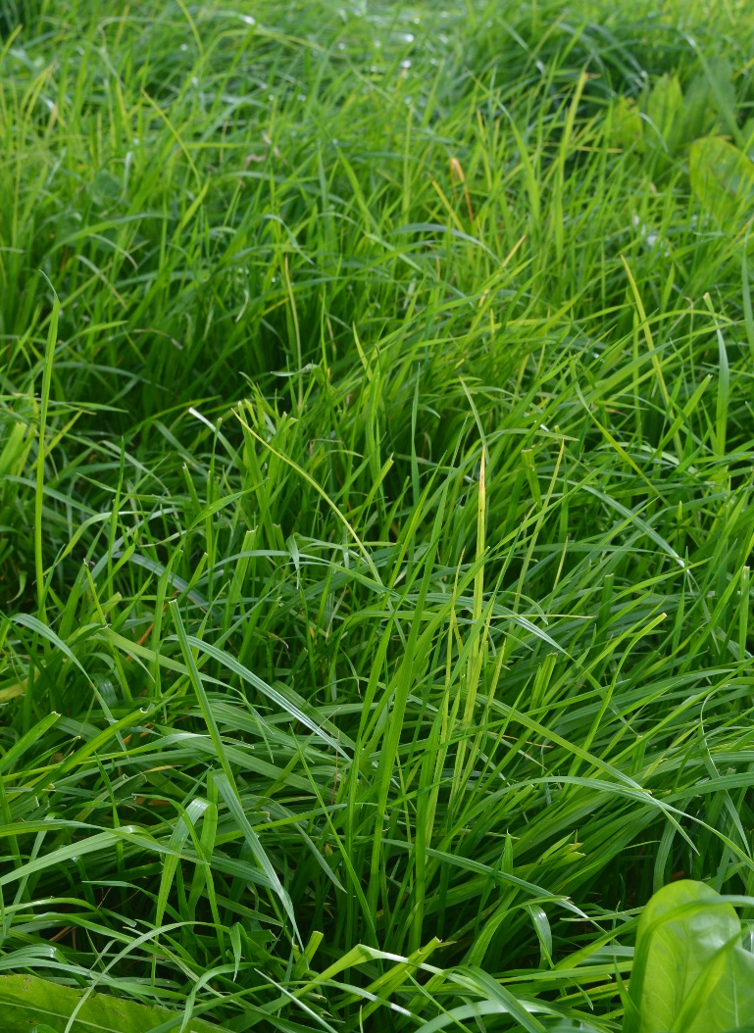
Pasture management
Rotational grazing, the practice of moving grazing livestock between pasture, reduces selective grazing. It can encourage the spread of good grasses.
Pasture improvement
Sowing legumes, clovers and/or grasses can provide high quality winter and spring feed. This usually requires investment in fertilizer. Provide Alternate Feeds
Good alternatives include supplementary feeds, feedlots and forage crops.
Increasing feed quality & animal performance

Slide 19
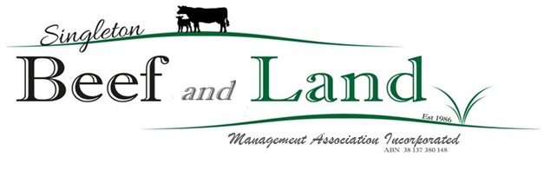
Thank you
We have over 30 years experience in promoting the local beef industry. Our activities include:
Farm tours
Workshops
& sessions
Field days
Guest speakers
Monthly meetings
Bus tours
Dinners
If you would like to become a member please contact us:
singletonbeefandland@gmail.com
www.singletonbeefandland.org.au

