Slide 1


Your new cattle have arrived
Prepared by Ian Blackwood,
Industry Beef Consulting PTY LTD,
for Singleton Beef & Land Management Association.
Proudly supported by

Slide 2
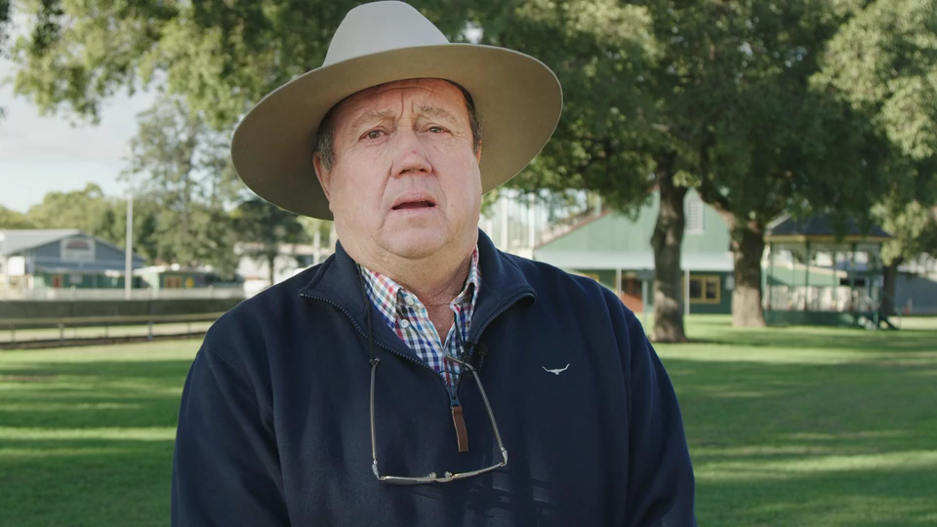
Watch: Welcome & enjoy!

Slide 3
Getting cattle
Your new cattle have arrived!
First, you must ensure the traceability of your animals.
You’ll need a National Vendor Declaration (NVD) which is a key legal document for traceability and market access.
NVDs were updated in July and apply to all future transactions. From 1st January 2021, only the updated versions of NVDs will be accepted.
You can find the new e-NVDs, how-to guides and further details at:
integritysystems.com.au/on-farm-assurance/national-vendor-declaration-nvd

Slide 4
The PIC method
Has the animal been transferred from a property to your school using the Property Identification Code (PIC) method?
PIC is an eight-character code allocated by the Department of Primary Industries (DPI) or other authorities to identify a livestock-producing property.
Producers must have a PIC to move livestock on and off a property.
Talk to the Veterinary Services Section of your Local Land Services or visit www.integritysystems.com.au to find out more.

Slide 5



Traceability of cattle
Once you have the NVD and PIC sorted, your animal is now traceable to your school from the property it was sent from.

Slide 6

Other important
things to consider
1
Was the animal born on the property it was sent from?
All animals leaving a property must have an NLIS accredited device before moving. This device is a visual or electronic ear tag. You can learn about the colour of NLIS tags and what they mean at www.nlis.mla.com.au.
2
Did you receive an Animal Health Statement from the supplier?
Buyers should ask for a statement and use it to determine the health risks associated with the animal offered for sale. You can contact the Veterinary Services Section of your Local Land Services or visit www.farmbiosecurity.com.au/toolkit/declarations-and-statements to learn more.
3
Put all this information together as the record of your animal.

Slide 7
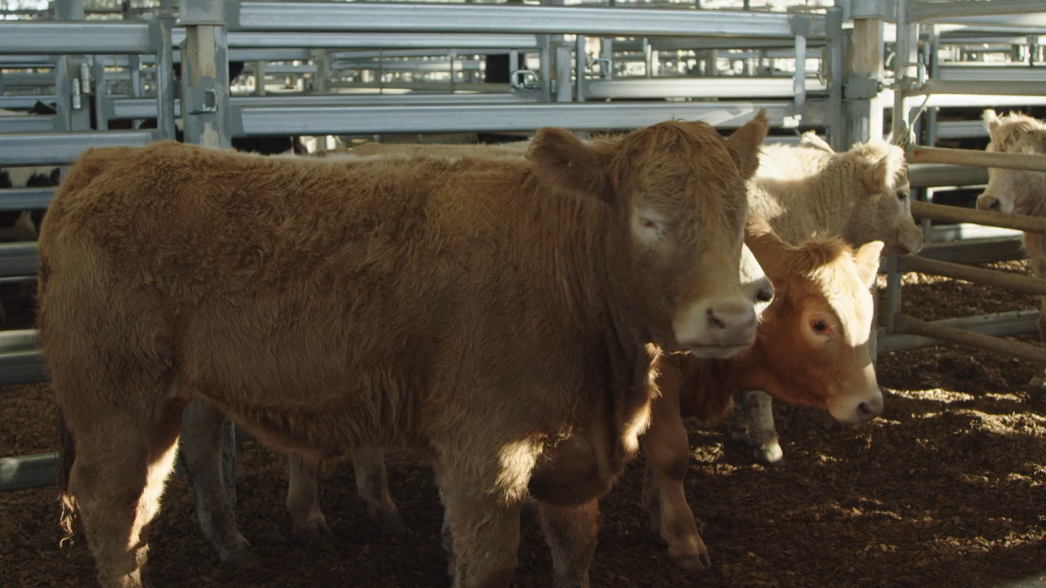
Watch: Traceability of cattle

Slide 8
Pop quiz
Q: What are the two main things you need to trace your cattle?
A: NVD and PIC
Q: What does PIC stand for?
A: Property Identification Code
Q: What is an NLIS accredited device?
A: An ear tag that identifies your animal

Slide 9
Settle your animal
Settle
Settle the animal by having a mate or two to be with.
Water
Fresh water, cereal hay and shade.
Let
Let the animal meet the new home.
Teach
Other cattle will teach the animal about the new surrounds.
Have
Always have the animals in one group for at least 2 weeks.

Slide 10
Activity: Make a timetable
Draw up a timetable for the animal’s time with you.
Use a spreadsheet to plan your timetable.
Include any teach lead time, school holidays and Show dates including your final Show date.

Slide 11
Show advice
If your final Show is a Hoof and Hook Competition, be aware:
Your animal will be distressed when mixed with other animals prior to loading, during transport and in their company in lairage at the abattoir.
Prior to loading, only one person should be with the animal to minimise this distress.
In the last 72 hours before being mixed with ‘new’ cattle, make sure your animal is eating well and is drinking clean water.

Slide 12
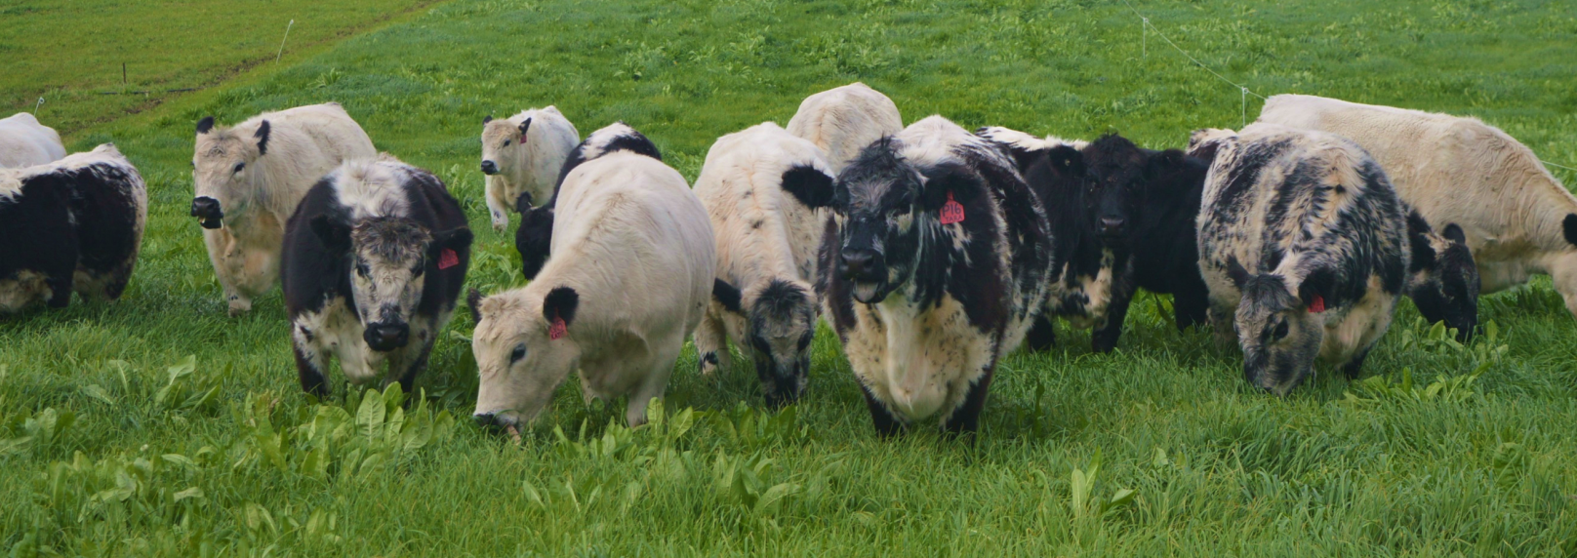
Now to feed
Next stop…
Take a look at the next PowerPoint on feeding your animal!

