Slide 1


Feeding your Show steer
Prepared by Ian Blackwood,
Industry Beef Consulting PTY LTD,
for Singleton Beef & Land Management Association.
Proudly supported by

Slide 2
How much feed do you need?
Start a spreadsheet to work out how much feed you need. Consider the following:
1. Number of days to be fed
2. Introduction diet for 21 days
3. Production diet
4. The live weight of your animal after 10 days at
your school.

Slide 3
Intro to grain feeding
Rule 1: Cattle are able to eat up to 2.8% of their live weight.
Rule 2: The 2.8% means Dry Matter (DM).
Rule 3: All calculations for feeding are done in DM.
Rule 4: The digestibility of the feed determines how much the animal will eat.
Rule 5: Weigh everything.
Rule 6: Convert DM weights to ‘As Fed’ (what you’ll actually weigh).

Slide 4
Feeding example
A manufactured feed will be 90% DM so to feed 8 kg of DM per day, the calculation is:
8kg divided by 0.90 = 8.88 kg ‘As Fed’
Do the same calculation for the hay you feed.

Slide 5
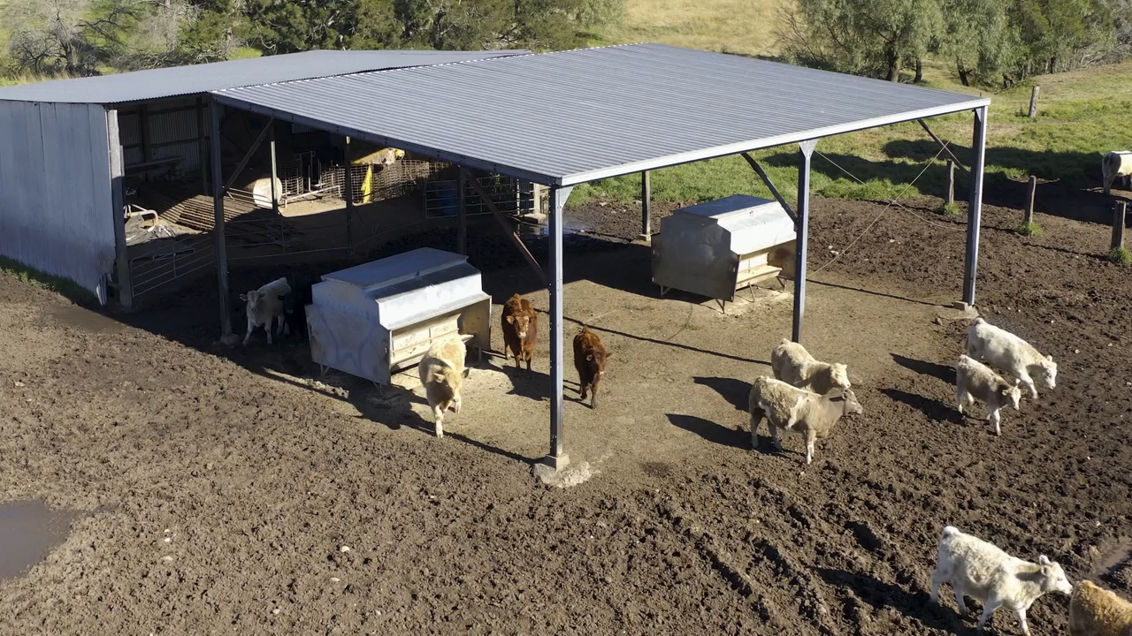
Watch: Importance of planning

Slide 6
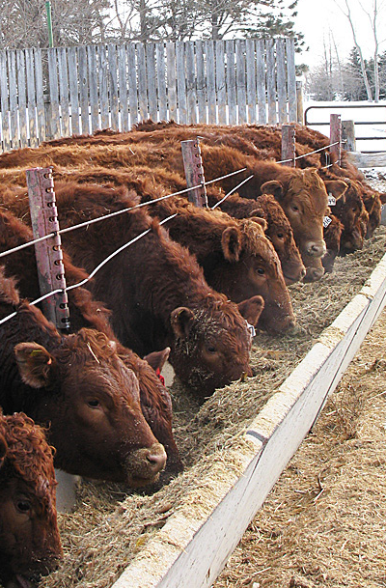
Intro to grain feeding
Buying Grains/Manufactured Feeds
Tip 1: Buy grains/manufactured feeds in bulker bags.
Tip 2: Have the grain analysed for energy and crude protein.
NSWDPI have a Stock Feed Analysis Service that may be helpful: https://bit.ly/2CbIFAV

Slide 7
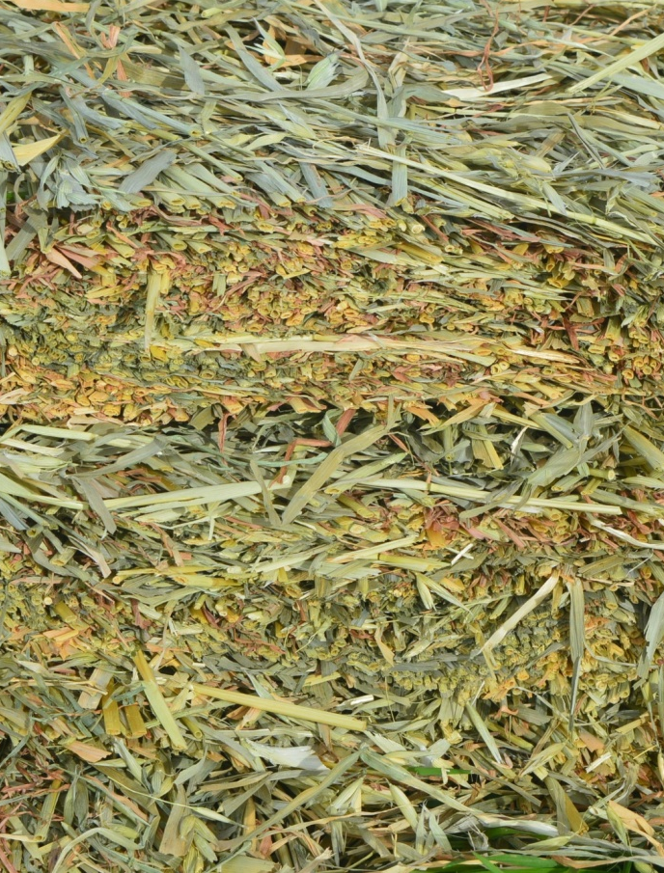
Intro to grain feeding
Buying Hays
Tip 1: Buy cereal hay (oaten/barley/hay) or cereal hay with a legume content (lucerne/vetch/cow peas).
Tip 2: Buy 1 tonne at a time.
Tip 3: Talk to the stock feed supplier about what best suits your needs.

Slide 8
Design the diet activity
To complete this task go to the NSWDPI Website and use the online feed calculator: https://bit.ly/3fz1o8a
Feeding Day 8 to 15: do not exceed 50% by weight of grain/manufactured feed in the diet.
Feeding Day 16 to 23: do not exceed 60% by weight of grain/manufactured feed in the diet.
Feeding Day 24 and onwards: do not exceed 70% by weight of grain in the diet.
Calculate the feeding amounts for the periods below
Feeding Day 1 to 7: do not exceed 40% by weight of grain/manufactured feed in the diet.

Slide 9

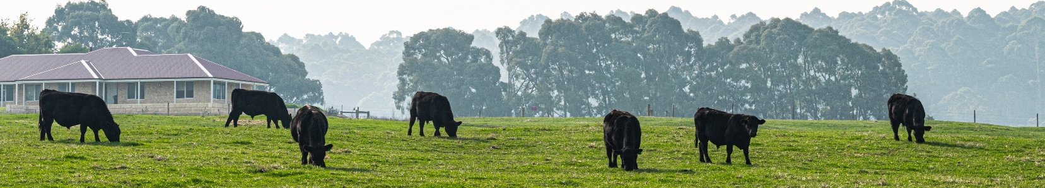
Diet tips
1
Always feed the hay unprocessed.
Unprocessed hay keeps the rumen working best.
2

Slide 10
How much feed will you need??
Go back to your spread sheet.
Add columns and calculations to work out:
1. How much each of the grain
and roughage you will need.
2. The feed budget (cost of the feed
delivered to your school).

Slide 11
Feeding Tips
Tip 1:
Feed your animal at the same times each day.
Tip 3:
Always have hay available for the animal
to eat whenever it chooses to.
Tip 4:
If there is feed left over from the last feeding, collect it, weigh it and dispose of it.
Tip 2:
Feed twice daily in equal amounts (half the daily amount at each feed).

Slide 12
Tip 5:
From left over feed, work out the amount your animal actually ate.
Tip 6:
Ask yourself whether you need to adjust the amount fed.
Tip 7:
If the animal is fussy, use molasses as an attractant (mixing it into the feed).
Tip 8:
Still not eating the feed? Water intake down? Best to call your vet to assess the animal.
Tip 9:
Keep feed and water troughs clean. Try doing weekly cleans.
Tip 10:
Once you’ve considered all the tips, try feeding your animals at LIB on a self feeder 24/7.

Slide 13
Water
Install an in-line water meter if you water the animal from a trough.
Record the daily water measurement.
From the measurements calculate the daily water intake.
Before you take the animal to Shows, add molasses to the water (add 2% molasses by weight of water on offer) at least once a week.
Why? Because it masks the water taste at the Show venue. You will treat the water there and the animal will drink.
1
2
3
4

Slide 14
Pop quiz
Q: How many times should you feed a day?
A: Twice a day
Q: If your animal is fussy, what should you mix into the feed?
A: Molasses
Q: Why should you add molasses to the water before you take the animal to Shows?
A: Because it masks the water taste at the Show venue

Slide 15
Watching Manure
To feed cattle - especially Show cattle - you must observe
their manure.
The manure should always be moist, and the pat must be formed with concentric circles.
Liquid manure usually has an odour… it’s not good! Decrease grain/manufactured feed and increase hay for one week.
Scalding of the body hair below the anus indicates acidosis (as for Tip 2 above).
The 70% grain/manufactured feed and 30% roughage (hay) will achieve Tip 1.
1
2
3
4

Slide 16
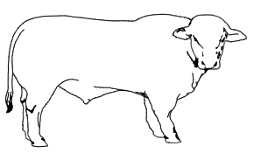
What will your animal look like at the end?
To see what your animal will look like at the end of your feeding, go to the NSWDPI BeefSpecs Calculator: https://bit.ly/3hDkcoj
What are the final live weight and fat depth estimates calculated?

Slide 17

Thank you
We have over 30 years experience in promoting the local beef industry. Our activities include:
Farm tours
Workshops
& sessions
Field days
Guest speakers
Monthly meetings
Bus tours
Dinners
If you would like to become a member please contact us:
singletonbeefandland@gmail.com
www.singletonbeefandland.org.au

